Slide 1
Summer Intern Project PPT On Analysis and Analytics of Photodiode
At
Solid State Physics Laboratory
Defence Research and Development Organization Timarpur, Lucknow Road, Delhi-110008

Slide 2
Under the guidance of Dr. Raghvendra Sahai Saxena(Scientist F)
Submitted by –
ASHISH RANA
2K17/CO/080
ABHISHEK DUNGRIYAL
00114807717
NAVEEN LAKHCHAURA
00814807717
PRASHUN CHAKRABORTY
41916412817

Slide 3
DATA ANALYSIS AND ANALYTICS?
Analysis is separating out a whole into parts, study the parts individually and their relationships with one another.
For example - if we have a whole data set and we are doing analysis on it means we pull sample data set from the whole data and then learn more about it and how it is related to the other samples.
Analytics is the principle or logic that drives the analysis.
For example - As mentioned in above example when we pull the sample and do analysis on it, the techniques or logic we are using to analyse the sample is analytics.
Analysis and analytics is to think in terms of past and future.

Slide 4
MACHINE LEARNING
Machine Learning is the field of study that gives computers the capability to learn without being explicitly programmed. ML is one of the most exciting technologies that one would have ever come across. As it is evident from the name, it gives the computer that which makes it more similar to humans: The ability to learn. Machine learning is actively being used today, perhaps in many more places than one would expect.
Types of machine learning problems
What is Supervised Learning?
Supervised Learning is the one, where you can consider the learning is guided by a teacher. We have a dataset which acts as a teacher and its role is to train the model or the machine. Once the model gets trained it can start making a prediction or decision when new data is given to it.
What is Unsupervised Learning?
The model learns through observation and finds structures in the data. Once the model is given a dataset, it automatically finds patterns and relationships in the dataset by creating clusters in it. What it cannot do is add labels to the cluster, like it cannot say this a group of apples or mangoes, but it will separate all the apples from mangoes.
Suppose we presented images of apples, bananas and mangoes to the model, so what it does, based on some patterns and relationships it creates clusters and divides the dataset into those clusters. Now if a new data is fed to the model, it adds it to one of the created clusters.

Slide 5
DATASET WE ARE WORKING ON IS OF PHOTODIODE
A photodiode is a PN-junction diode that consumes light energy to produce electric current. Sometimes it is also called as photo-detector, a light detector, and photo-sensor. These diodes are particularly designed to work in reverse bias condition, it means that the P-side of the photodiode is associated with the negative terminal of the battery and n-side is connected to the positive terminal of the battery. This diode is very complex to light so when light falls on the diode it easily changes light into electric current. The solar cell is also branded as large area photodiode because it converts solar energy into electric energy. Though, solar cell works only in bright light.

Slide 6
RESEARCH PAPERS WE GO THROUGH DURING THIS REPORT
Electrical characteristic signatures for non-unifomity analysis in HgCdTe photodiode arrays
Mercury Cadmium Telluride (HgCdTe) is dominant in case of IR detection.
It has tunable band-gap and high sensitivity.
Fragile and defect prone material
The paper proposes a method to quickly analyse the performance, non-uniformity using signature of dynamic resistance voltage characteristics.
Discription is done for Mid Wave Infrered Region (3-5 µm IR wavelength)

Slide 7
THE MAIN ELEMENTS THAT ARE PRESENT IN THE DATA SET ON WHICH
WILL PERFORM ANALYSIS ARE:
V (VOLTAGE)
I ( CURRENT)
RD ( DYNAMIC RESISTANCE )
IN OUT MODEL FOR THE ANALYSIS THERE ARE INDEPENDENT AND DEPENDENT VARIABLES
Here V and I are the independent variables
RD is the dependent variable
Prediction are on the basis of RD

Slide 8
Electrical Characteristics Of HgCdTe photodiode
Dark Current Mechanisms are as follows:
Thermal Diffusion current.
Generation - Recombination in space charge region (G-R).
Trap AssisstedTunneling.(TAT).
Band to Band Tunneling.
Surface Leakage through ohmic shunt.
2. In case of MWIR HgCdTe, effort of BTB current is negligibly small.
Total current and overall dynamic resistance depends on parameters governing current mechanisms.
4. In typical HgCdTe, the forward biased region is dominated by G-R till certain voltage.
Diffusion current becomes dominant until series resistance starts limiting the current flow.
6. At reverse bias, TAT becomes the only dominant mechanism.

Slide 9
Learning system model
Testing
Input Samples
Learning Method
System
Training

Slide 10
Training and testing
Data acquisition
Practical usage
Universal set
(unobserved)
Training set (observed)
Testing set
(unobserved)

Slide 11
Training and testing
Training is the process of making the system able to learn.
No free lunch rule:
Training set and testing set come from the same distribution
Need to make some assumptions or bias

Slide 12
Performance
There are several factors affecting the performance:
Types of training provided
The form and extent of any initial background knowledge
The type of feedback provided
The learning algorithms used
Two important factors:
Modeling
Optimization

Slide 13
Algorithms
The success of machine learning system also depends on the algorithms.
The algorithms control the search to find and build the knowledge structures.
The learning algorithms should extract useful information from training examples.

Slide 14
Multiple Linear Regression Models
Many applications of regression analysis involve situations in which there are more than one regressor variable.
A regression model that contains more than one regressor variable is called a multiple regression model.
Multiple Linear Regression attempts to model the Relationship between two or more features and a response by fitting a linear equation to observed data. The steps to perform multiple linear Regression are almost similar to that of simple linear Regression. The Difference Lies in the Evalution. We can use it to find out which factor has the highest impact on the predicted output and now different variable relate to each other.
For example, according to the givin data the Dynamic Resistance depends on the Voltage and the Current. A possible multiple regression model could be

Slide 15

So according to the model
WHERE
Y – DYNAMIC RESISTANCE
x₁ – VOLTAGE
x₂ – CURRENT

Slide 16
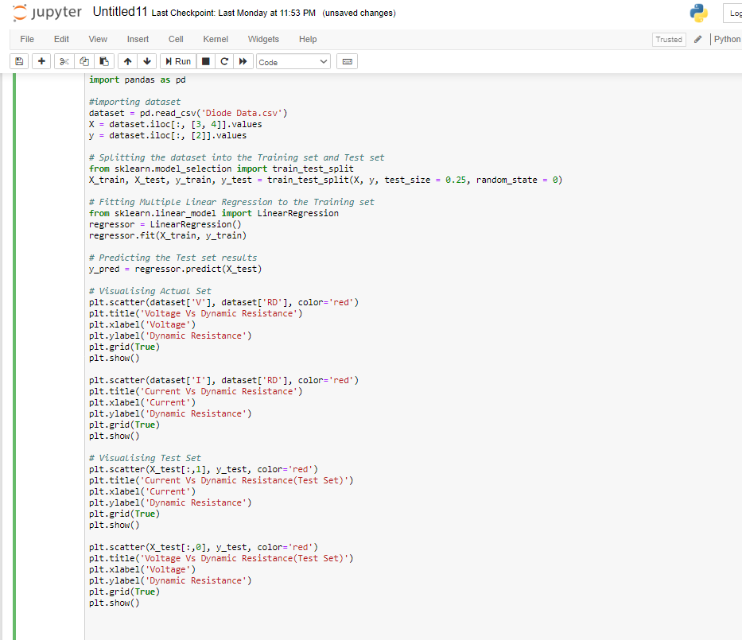

Slide 17
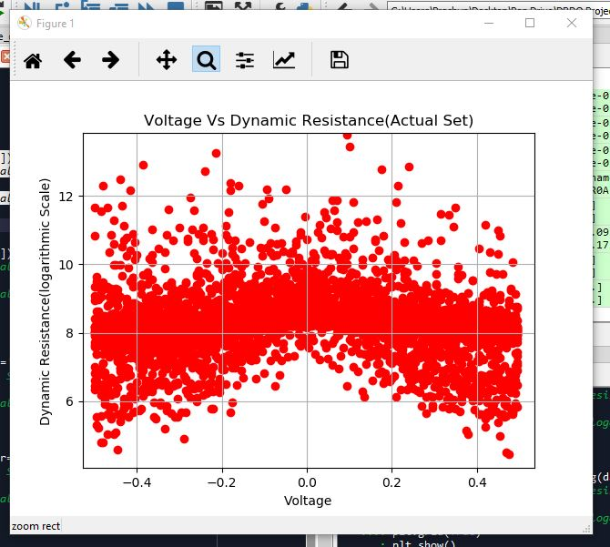
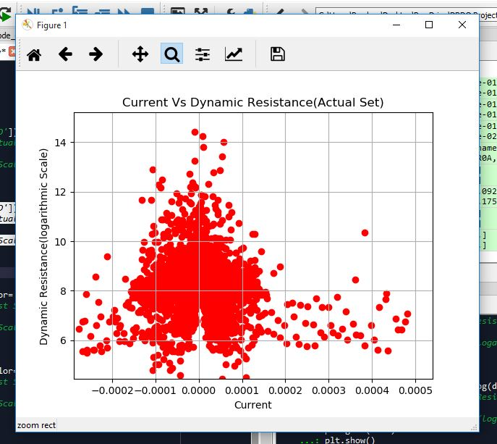
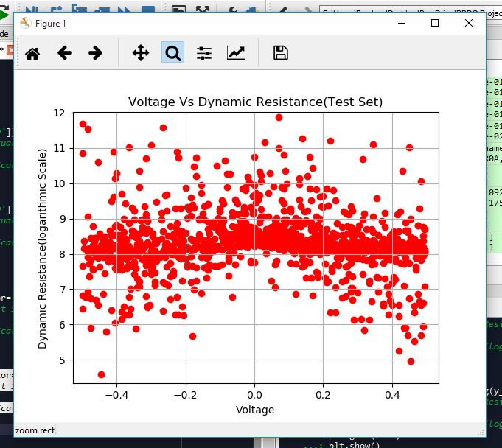
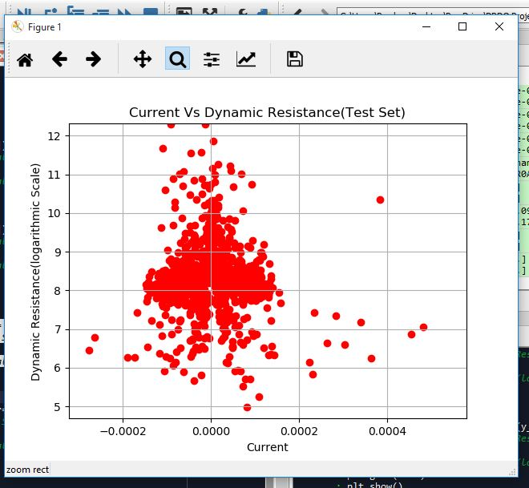

Slide 18
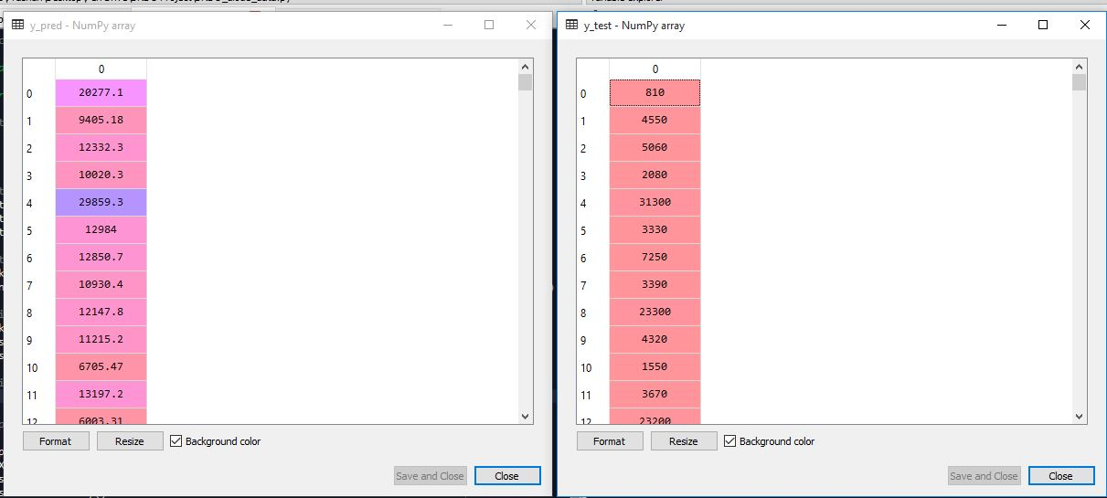
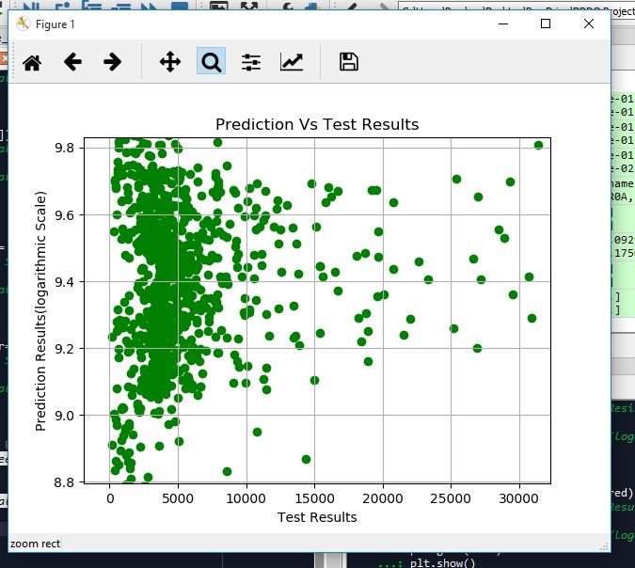

Slide 19
Visualization Of Data
Data visualization is viewed by many disciplines as a modern equivalent of visual communication. It involves the creation and study of the visual representation of data.
To communicate information clearly and efficiently, data visualization uses statistical graphics, plots, information graphics and other tools. Numerical data may be encoded using dots, lines, or bars, to visually communicate a quantitative message. Effective visualization helps users analyze and reason about data and evidence. It makes complex data more accessible, understandable and usable.
Data visualization is the graphical representation of information and data. By using visual elements like charts, graphs, and maps, data visualization tools provide an accessible way to see and understand trends, outliers, and patterns in data.
In the world of Big Data, data visualization tools and technologies are essential to analyze massive amounts of information and make data-driven decisions

Slide 20
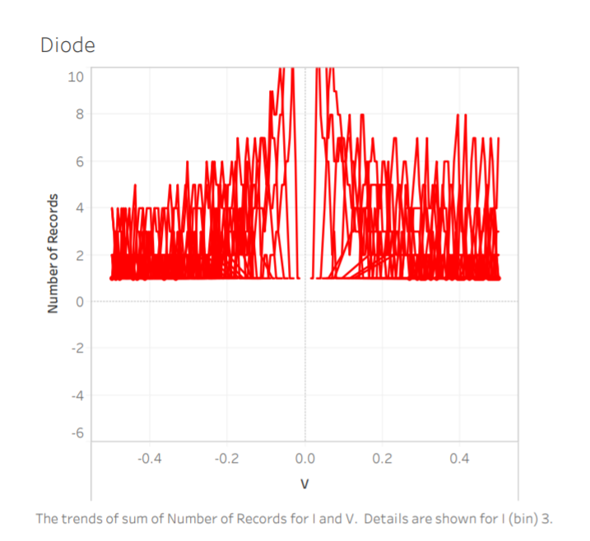
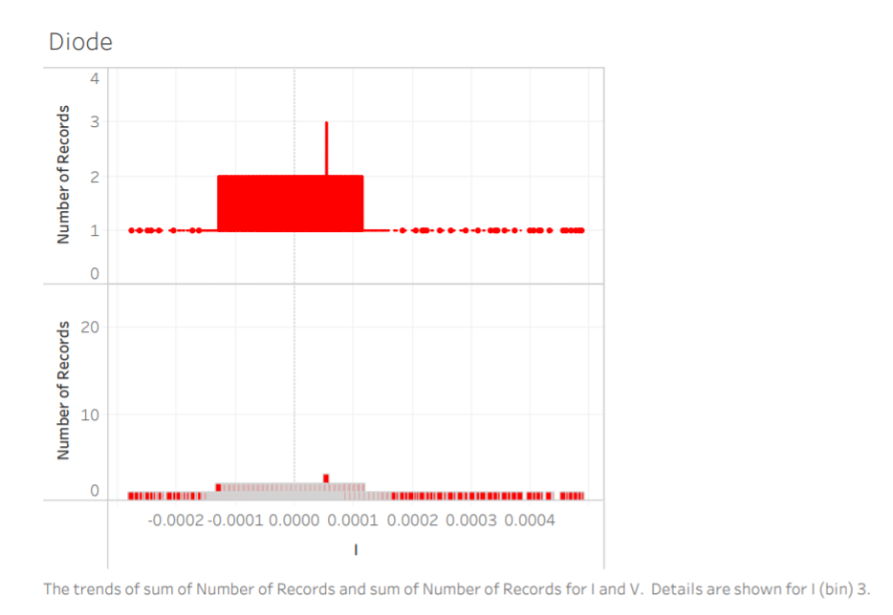
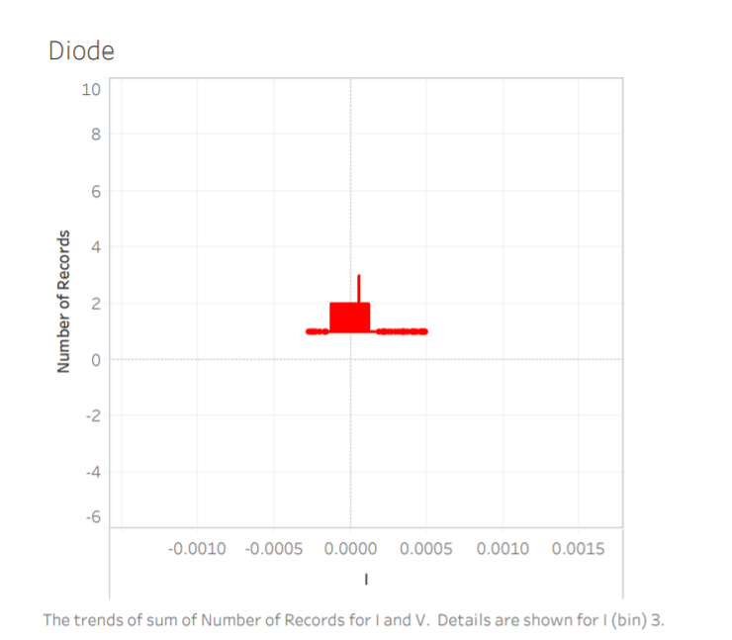
Visualization made by data analytics using Tableu

Slide 21
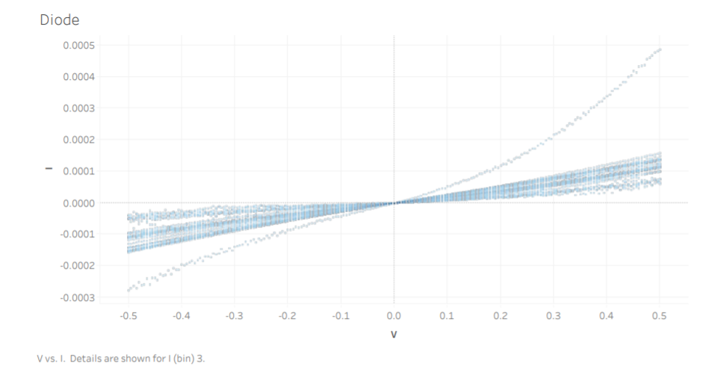
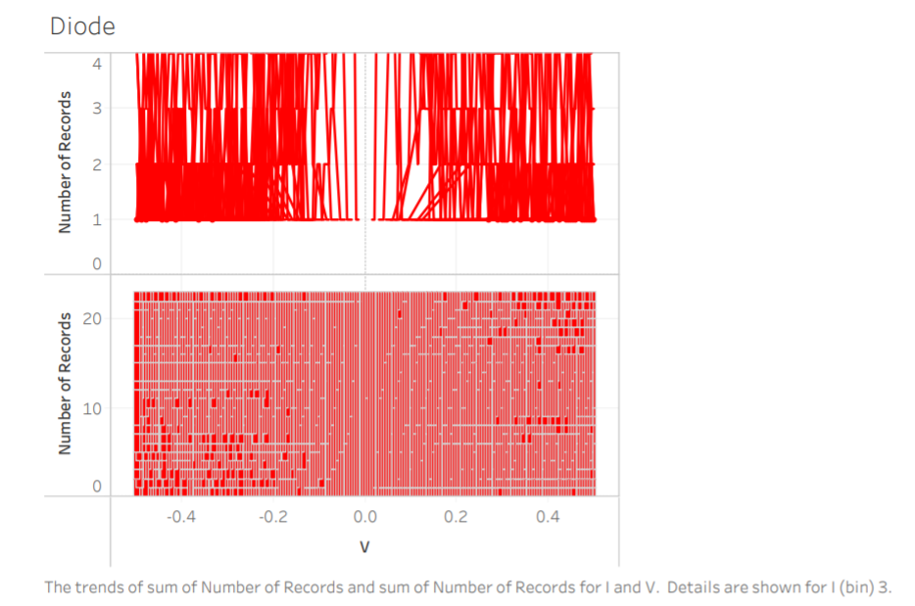

Slide 22
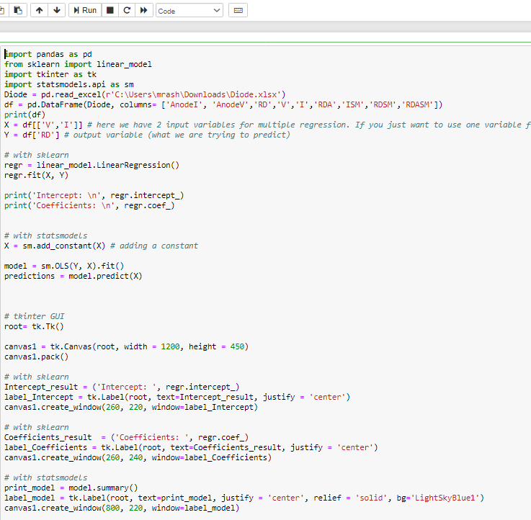
GUI

Slide 23
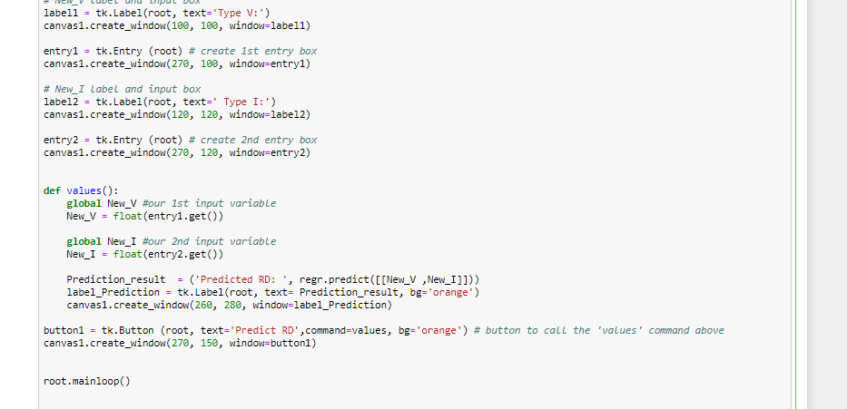

Slide 24
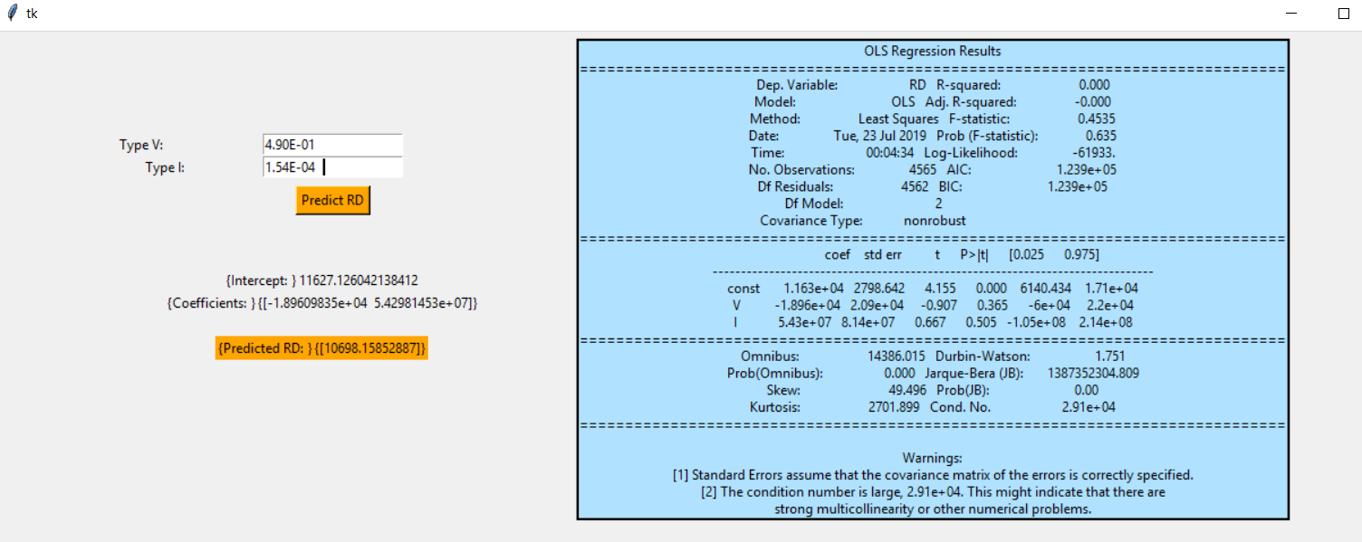

Slide 25
CONCLUSION
In this project, we have dealt with a data of over 4000 records. In data analysis, we study the patterns of the data provided and using data analytics we create a model through understanding the data provided properly. Data analytics requires knowledge of machine learning and algorithms. Through the concepts of machine learning, we check which algorithm fits the data the best which was Multiple Linear Regression in our case.
Here in this model, we predicted the values of dynamic resistance through the provided values of voltage and current of the given diode. Once the model is created, the visualisation of results is done so as to check the variation in predicted and actual sets. Here, multiple linear regression model predicts the values of dynamic resistance the best.

Slide 26
THANK YOU

